Slide 1
Booki
Real Team 6 (Group 6)

Slide 2
What we are working on:
Getting Flask to run.
Establishing routes to specified web pages as in the horizontal prototype
Start focusing on HTML Forms for Login, Registering, etc.
Start building database ORM so that it can accept input from HTML forms.

Slide 3
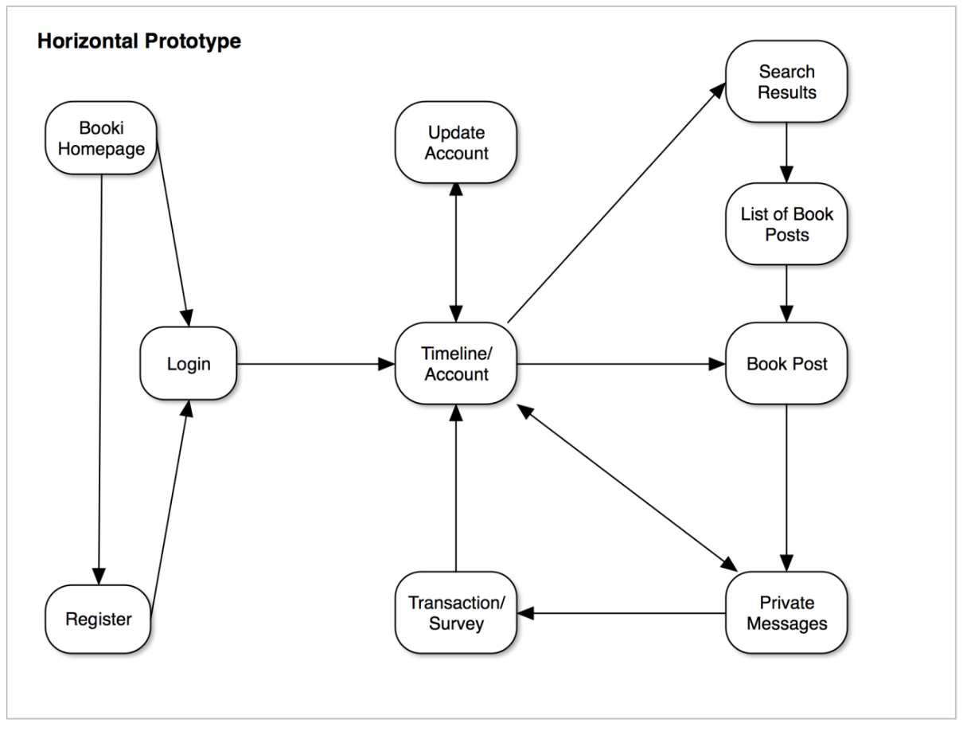

Slide 4
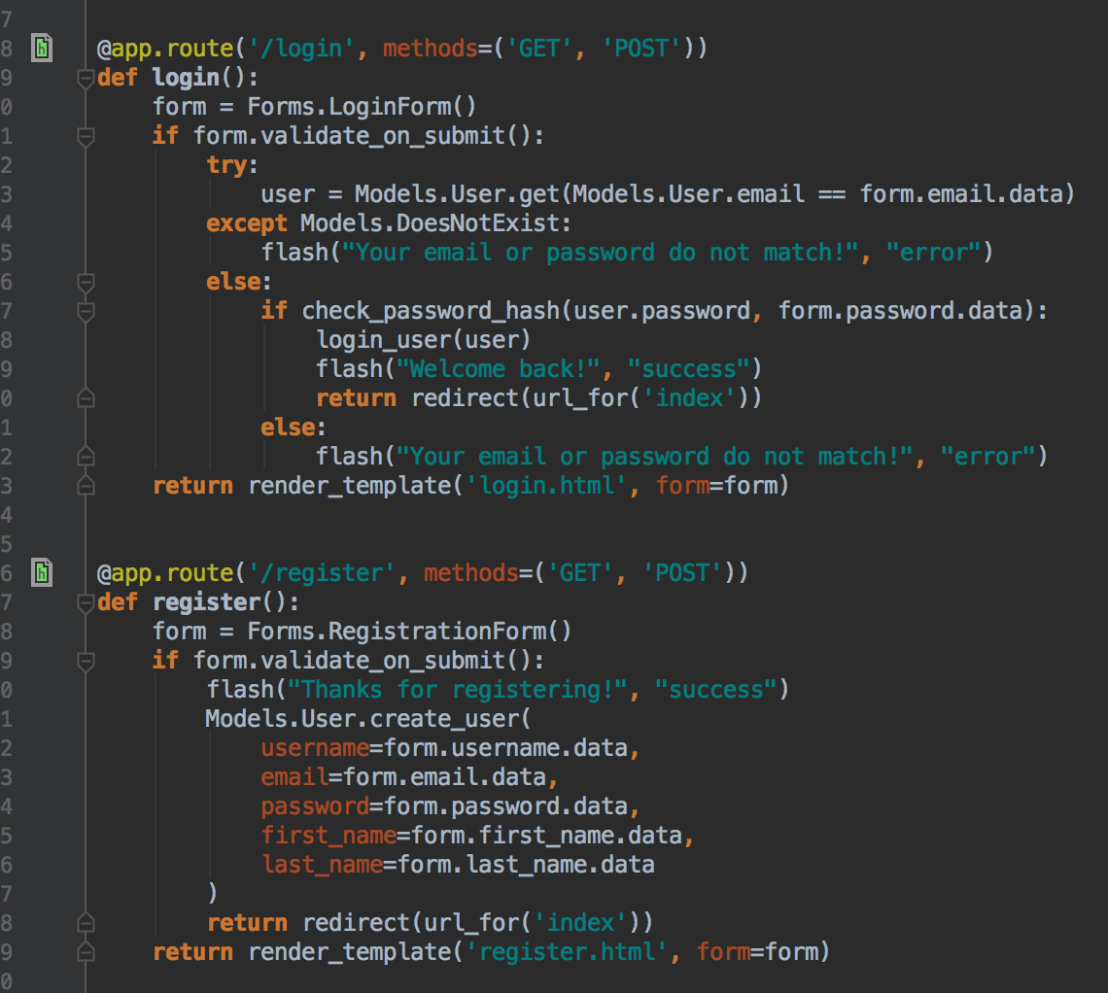
Routes
(Example)

Slide 5
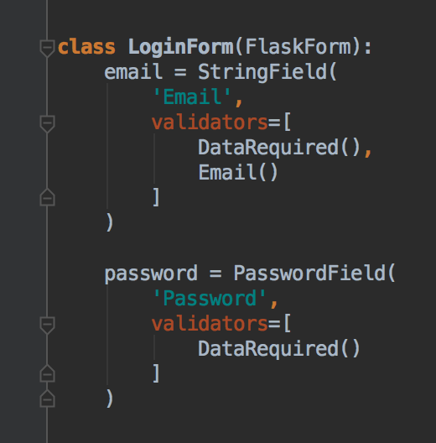
Forms
(Example)

Slide 6
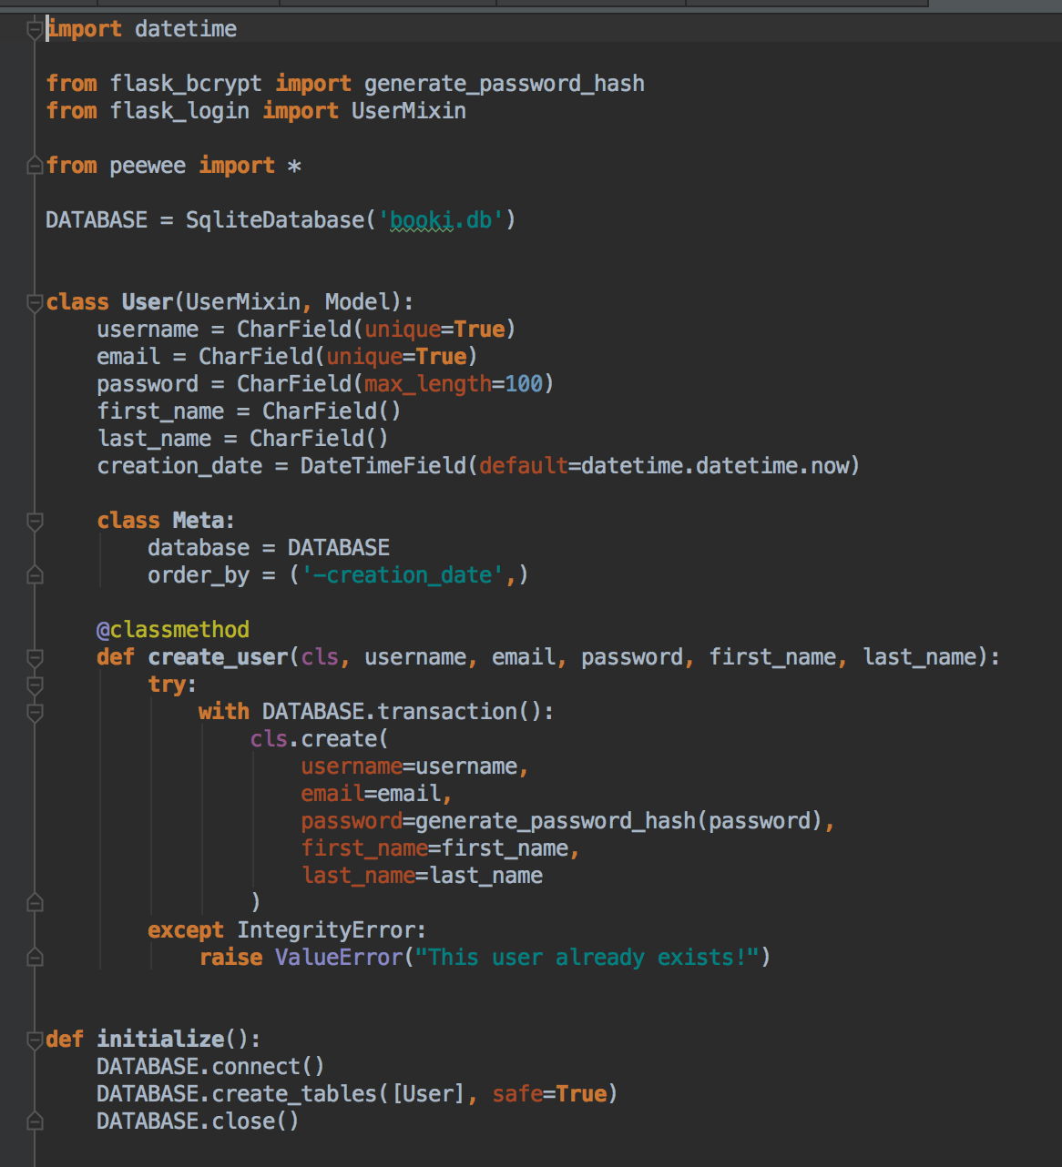
Models
(Example)

Slide 7
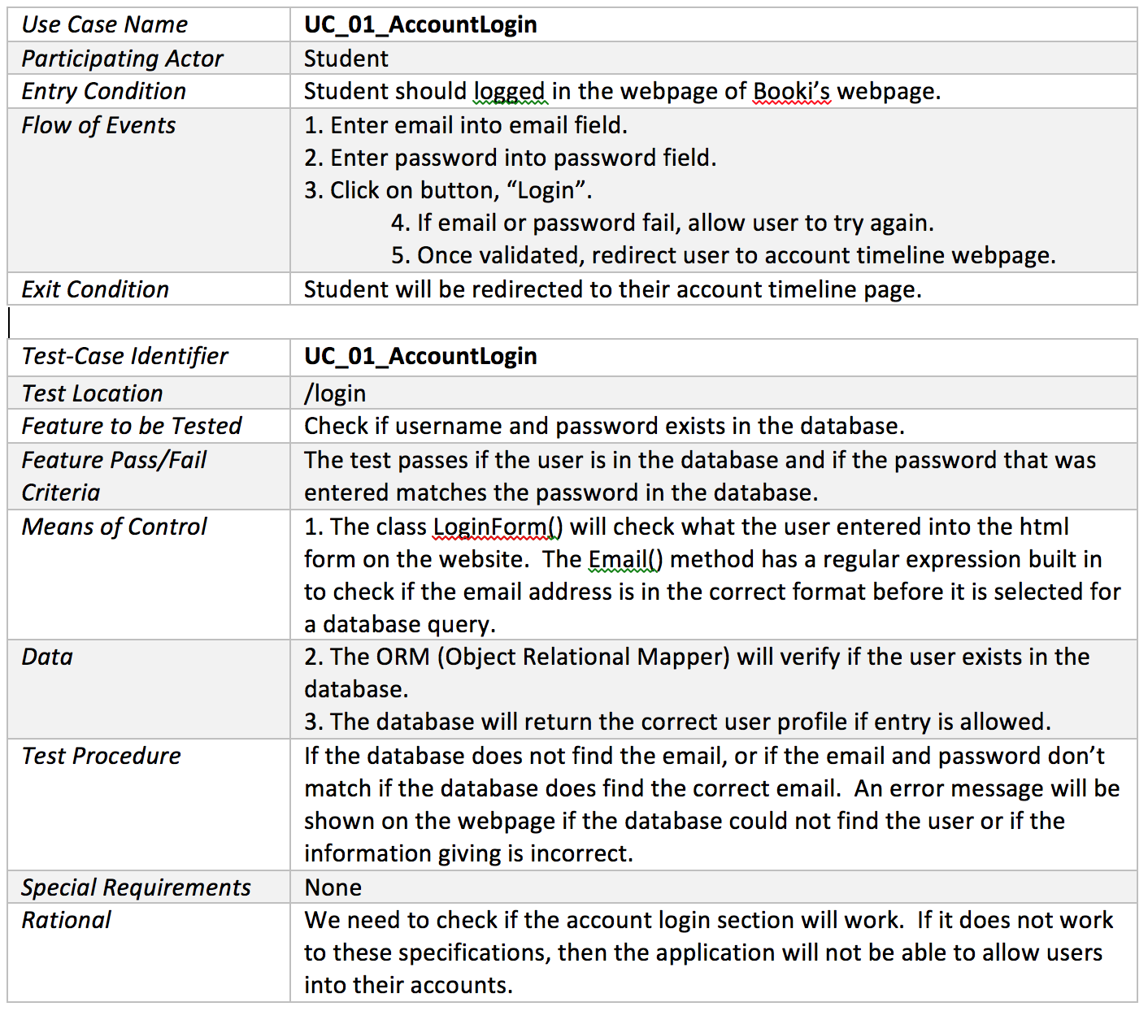

Slide 8
Questions?
Thank You

